Slide 1

Republic of Serbia
Fiscal Council
FISCAL CONSOLIDATION IN 2015 AND MAIN CHALLENGES FOR REFORMS
June 17, 2015

Slide 2
Fiscal plans for 2015 are being realized, but key reforms have not been initiated
The deficit in 2015 has been decreased (as we estimate) from about 6.6% in 2014 to a little under 5% of GDP
  Lasting deficit decrease of almost 2 pp – excellent, but only a start
    Cuts to pensions and salaries in the public sector, better revenue collection, excises increase
  Better than the planned deficit for 2015 (5.9% GDP)
  A possible deficit decrease in 2015 of 3 pp or more - temporary and undesirable
Reforms crucial for fiscal consolidation success have essentially not started, there are only minor improvements
  Public enterprise reform: ЕPS (the plan is behind schedule), Srbijagas (the Working Group for the resolution of the petrochemical company complex has only just been formed), Serbian Railways (still no lasting savings)...
  Resolution of the status of enterprises undergoing privatization: of a total of 93,000 employees, resolution of issues of companies hiring about a half of the total number of employees is being postponed
  Rationalization of the number of public sector employees: no precise plans yet.

Slide 3
Public sector reforms are essential
Without structural reforms, all other sacrifices may be wasted
  Budget spending on state-owned enterprises in the previous years has shown a very fast growth: from about 2% of GDP in 2012 to about 3% of GDP in 2013 and 2014.
  Without the implementation of adequate reforms, there is a danger that these costs could continue their strong growth in the future
  Planned savings from the rationalization of employees in the budget sector are about 100 million Euros per year, but only if implemented in a timely manner
There is no room for fiscal relaxation
  No grounds for the increase of salaries and pensions
  No grounds for VAT decrease

Slide 4
In 2015, fiscal deficit could be a little under 5% of GDP: good, sustainable
Structural savings compared to the previous year about 2 pp
  Public sector salaries and pensions cut: most significant savings at 1.5% of GDP
  Suppression of grey economy and better revenue collection: 0.5% of GDP (conservative estimates, higher savings are possible)
  Introduction of an excises on electricity: 0.2 of GDP
However, expenditures for interests increased compared to the previous year by a large 0.5% of GDP
  It was known and planned, but it is extensive – it equals, for example, the annual spending on the development of science and technology
Abandoning salary and pension cuts would restore the deficit to approximately the old level
  The deficit would increase by 1.5%, which would practically return it to the level of 2014 at 6.6% of GDP

Slide 5
A deficit below 4% of GDP possible, but unsustainable
Consequence of inefficient enforcement of economic policies, not of additional improvement in fiscal trends
Public investments are being implemented at a slower rate
  In the first four months, about 15% of the planned public investments have been implemented, whereas it is common for about 20% of the plan to be realized by this point
  If the delays continue, investment realization could come in 1 pp of GDP under plan
Severance payments for excess public sector employees are delayed
  16bn allocated in the budget for severance payments for employees of companies in privatization, 8bn for the budget sector employees; in the first four months, little was paid
  Solution of companies’ problems is postponed, and there is no precise plan for rationalisation of the number of employees in the budget sector
Temporary savings: will increase the deficit in the years to come
  Severance payments will be there waiting in the upcoming years, as will unconstructed roads and other infrastructure

Slide 6
Planned expenditures for salaries in the budget sector will be realized, even without significant lay-offs
Planned spendings reduction for employees in 2015 was primarily based on the salary cut and downsizing
Even though there will be no lay-offs in 2015, or there will be fewer than planned, the budgeted expenditures for salaries will be realized
  The years of service are calculated differently – taking only the time spent with the last employer into consideration
  Working in shifts has been abolished as a salary increment, and other salary increments have been decreased
  The outflow of employees into retirement (attrition rate) increased at the end of last year, to avoid more stringent retirement conditions that came into force in 2015

Slide 7
Lay-offs in 2015 are still necessary
To realize fiscal plans for 2016, the announced lay-off of 9,000 employees needs to be enforced by the end of 2015
  One of the main measures for deficit decrease in 2016 is the decrease in expenditures for salaries by 5%
  For this plan to become a reality, the savings need to be effectuated from 1.1.2016, i.e. 9,000 excess employees in the budget sector need to be laid off by the end of 2015
  Otherwise it would be necessary to lay off about 10% of employees in 2016 in order to realize the fiscal plans for 2016: socially and politically unfeasible
Ministry of State Administration has already announced lay-offs for 9,000 employees in 2015
  However, no precise plan
    All that is known is that a half of these excess employees are in local governments and the other half at the level of the Republic
  The question is whether competent Ministries accept the analysis of the Ministry of State Administration and when they will initiate reforms in their sectors

Slide 8
High expenditures for interests and a high deficit in 2015 → at least three more years of fiscal consolidation
Expenditures for interest payment will exceed 1.1 bn Euros (3.5% of GDP) in 2015 – among the highest in Europe
  Only 6 European countries have higher interests spendings relative to their GDP
  For instance, Greece with a debt of 180% of GDP pays only 0.7 pp of GDP more for interests than Serbia and by 2017, the interests in Serbia will reach 4%, practically cancelling out the difference in comparison to Greece
  We spend more on interests than we do on public investments, which are the best type of public spendings (122 bn budgeted for investments, while interests will exceed 140 bn dinars in 2015)
No room for giving up on fiscal consolidation measures
  In the upcoming years, expenditures for interests will increase by about 0.5% of GDP on average
  This means that each following year it will be necessary to save on expenditures (or increase revenues) by the same amount just to keep the deficit at the current level

Slide 9
Expected economic growth leaves no room for fiscal relaxation
At the moment, we retain our assessment for 2015: a 0.5% drop in GDP
  This is indicated by a large year-on-year drop in the first quarter of about 1.8%
  Recession has been present since the second half of 2013, it is not to be blamed on floods or fiscal consolidation
Many open issues could have a significant effect on GDP in 2015
  A highly successful agricultural season could increase the GDP growth above 0%, while an unsuccessful one could decrease it below -0.5%
No signs of sustainable recovery – growth of net export and investments
  In the first quarter, there was a solid y-o-y growth in investments of 4.4% , but due to the structure of this growth it is uncertain if it can continue until the end of the year
  Net export has even dropped in the first quarter
Independent of GDP growth rate that will be achieved, economic activity trends indicated by the start of 2015 cannot be evaluated as positive

Slide 10
Reforms – the main leverage for deficit decrease after 2015
The foundations for a lasting recovery in public finances lie in the implementation of structural reforms
  The announced deadline for the status of petrochemical companies has been exceeded
  Plan for the financial restructuring of EPS was adopted in June (instead of March), with the only measure so far being an increase in electricity tariff
  Transformation plans for Tax Administration are running late and deep reform of this department is key for the suppression of grey economy
  Downsizing of the budget sector has not yet begun
Structural reforms are one of the corner stones of the arrangement with the IMF
  Quarterly reviews encourage keeping up with the announced reforms, as hard as they may be

Slide 11
Strong public revenue collection
Non-tax revenue
  One-off effects and temporary factors
  High collection will not persist in the upcoming years
Tax income ~ 35 bn more collected
  Anti-evasion measures, mostly from excises
  Conservative budget plan for the VAT
  Partially better collection of contributions
  Profit tax lower due to the business cycle
  Lasting effects on the increase in public revenue

Slide 12
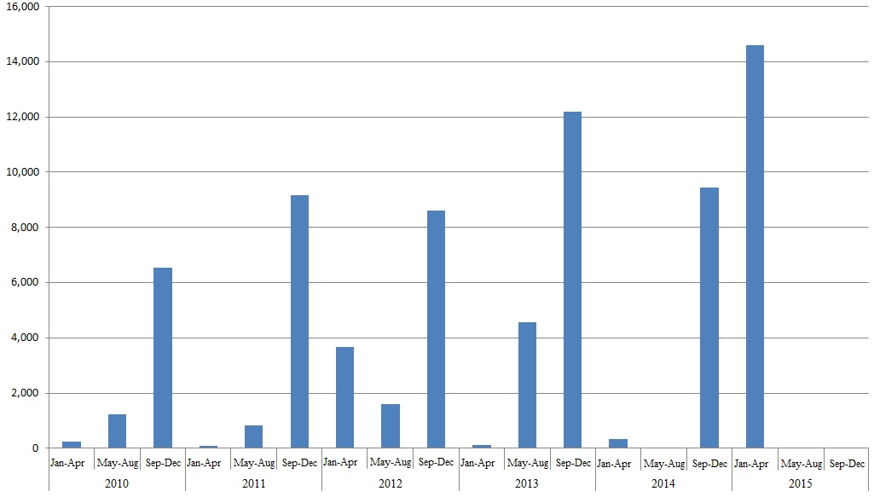
Dividends and profit from public companies
Collection at the beginning of 2015, instead of at the end

Slide 13
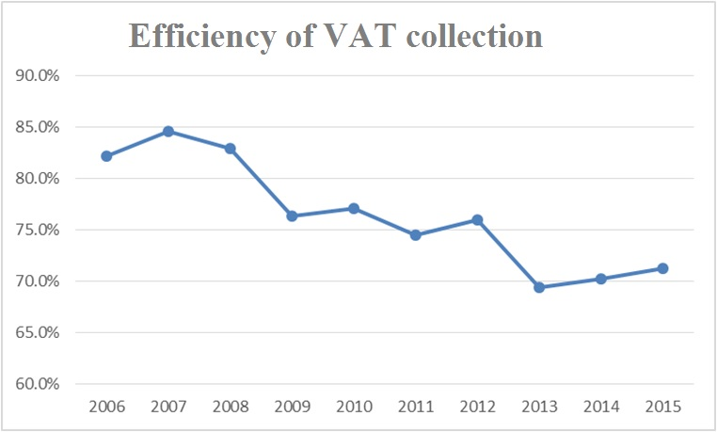
Tax income
Decrease in VAT collection stopped, mild growth
  Primarily due to improved excises collection

Slide 14
Tax Administration reform
Key prerequirement for grey economy suppression
  Rationalization and centralization of 173 organisational units of the Tax Administration
  Quantitative and qualitative staff capacity building
  Development of a comprehensive information system
A reform plan and its consistent use through several years are necessary
  Possible revenue increase of about 350 million Euros
Caution with the new (online) fiscalization
  Failed episode with wireless reading of fiscal cash registers
  High costs with no significant effects on grey economy

Slide 15
The method of rationalizing the public sector is still unknown
The Ministry of State Administration has issued a general analysis, but it is unknown if the Government is accepting obligations
  Obvious excesses identified:
  in healthcare, police, judiciary → reforms are needed in large state sectors
  The reaction of Ministries and Government is key
    That they accept the obligation,
    That they develop sector analyses by the end of the year
    That the Government adopts and implements the program starting from next year.
  Rationalization plans do not explicitly include solutions for the status of the (formally) employed in Kosovo and Metohija
    The unconstitutional “Kosovo increment” is still being paid
    Only formally employed in Kosovo, live and work in Central Serbia
    Unordered system, needs to be encompassed by the rationalization and the burden shared

Slide 16
New law is just an aid
Law on the Maximum Number of Employees
  Not vital, brings nothing substantially new
    The number of employees must fit into the budgeted amount for salaries, as was the case so far
  The key is still not to increase the salary fund through a supplementary budget
  New: precise criteria for determining the number of employees in local governments, but the downsizing dynamics have not been determined

Slide 17
Reforms in state enterprises are vital, but still at the beginning
State enterprises (still) cost a lot
  In total, for activated guarantees and subsidies, about 700 million Euros (2.1% of GDP)
  They are the greatest fiscal risk
    1 bn Euros paid through guarantees and subsidies for Srbijagas (3% of GDP), while EPS owes 1 bn Euros
First improvement announcements
  EPS – financial restructuring (electricity tariff), Serbian Railways – organization change, Srbijagas – awareness of the problem, gas transport fees and Work Group
Bad (“creative”) solutions need to be resisted
  EPS – merger with the previously separated enterprises, Srbijagas – takeover of loss-making companies, Railways– (only) ad hoc savings
Application of difficult reform measures has yet to come
  Professionally, politically and socially very challenging

Slide 18
EPS
  Increase in tariffs necessary, but just a first step in the mid-term
    Especially bearing in mind that only 4.5 out of 12% goes to EPS
  Up to 10,000 excess employees
    Limit severance pays to 200 Euros
  Decrease technical losses (new meters)
    One of the loans expires in June this year
Srbijagas
  The chemical complex is paying, but probably only temporarily
    1. Companies subsidized at the end of 2014 to pay for gas in this year
    2. Currently favourable price ratios: low import and high sales prices
  Development strategy unknown (alternative sources and investments, import gas price)
Serbian Railways
  Downsizing is necessary (by a third?), rationalization of the network and downsizing of the vehicle fleet
  Inefficiency in investment implementation
    Corridor 10, Žeželj’s bridge

Slide 19
Companies undergoing privatization
526 companies with 93,000 employees in this process
Group one (with one half of the employees, 353 companies) – planned to be solved quickly
    Bankruptcy (189 companies, 5,000 employees)
    Transfer into state ownership (47 companies, 2,000 employees)
    Removal of protection (117 companies, 40,000 employees)
Group two (with the other half of the employees, 173 companies) – resolution of status postponed
    Extension of protection from creditors (17+44 companies, 32,000 employees)
    Privatization postponed (82 companies, 4,500 employees)
    Privatization stopped (30 companies, 9,500 employees)

Slide 20
We support the solutions for group one, wherein it is necessary to:
  Insist on the initiated bankruptcies
  Insist on protection termination (blocks, sale or new bankruptcies);
  Avoid new transfers into state ownership
  Not increase severance payments
  Solutions for group two to take into consideration:
  Any delay incurs costs
    Spreading illiquidity, losses, taxes unpaid
  Caution when taking over commercial obligations
    Obligations of JAT in the amount of 20 bn dinars were taken over
    Potential growth of the public debt by 700 million Euros
  New investments only after the status is solved
    Questionable profitability of investments into RTB Bor, Petrohemija is mentioned?

